Slide 1
Design and Analysis of Algorithms
CS345
Lecture 5
Divide and Conquer Paradigm – IV
  The final Algorithm for Polynomial multiplication
  Stable Matching Algorithm

Slide 2
Recap from Lecture 1

Slide 3

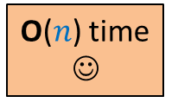

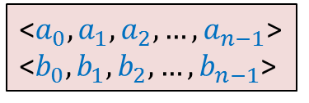
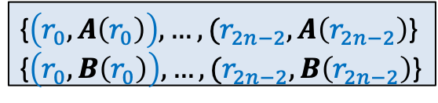
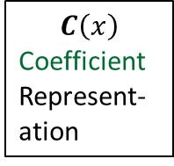


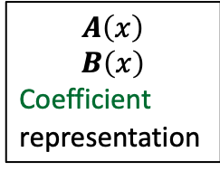

$C=A × B$
☹
$$C\left(x\right)$$
Coefficient
Represent-ation
$$A\left(x\right)$$
$$B\left(x\right)$$
Coefficient
representation
<$a_{0}, a_{1},a_{2},…,a_{n−1}$>
<$b_{0}, b_{1},b_{2},…,b_{n−1}$>
<$c_{0}, c_{1},c_{2},…,c_{2n−2}$>
O($n$ log $n$) time
O($n$ log $n$) time
Polynomial Evaluation
Polynomial Interpolation
{$\left(r_{0}, A\left(r_{0}\right)\right),…,(r_{2n−2}, A\left(r_{2n−2}\right)$}
{$\left(r_{0}, B\left(r_{0}\right)\right),…,(r_{2n−2}, B\left(r_{2n−2}\right)$}
{$\left(r_{0}, C\left(r_{0}\right)\right),…,(r_{2n−2}, C\left(r_{2n−2}\right)$}
O($n$) time
☺

Slide 4

Polynomial Evaluation Problem
Given a polynomial $A$ of degree less than $n$in coefficient representation,
Choose any set $S$ of $n$ numbers
Compute $A\left(v\right)$ for all $v∈S$.
Assumption:
$n$ is a power of 2.
In the last lecture, we discussed a divide and conquer based algorithm for polynomial evaluation. We were left with a question …

Slide 5
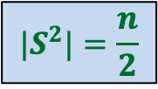



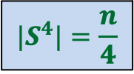
Question
Is it possible to select $S$ such that
…
$$|S^{2}|=\frac{n}{2}$$
$S$ = $\{2,3,9,−2,−3,−9\}$
$${|S}^{4}|=\frac{n}{4}$$
Good start !
But how to satisfy the remaining requirements …
$${|S}^{n}|=1$$

Slide 6
Complex numbers
Recalling elementary facts

Slide 7
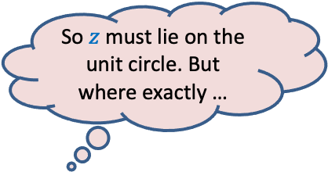

Complex roots of unity
Definition:
A number $z$ is said to be $n$th root of unity
if it satisfies equation.
$$z^{n}=1$$
$$z⋅z⋅z⋅ …⋅z=1$$
Magnitude($z$) = 1
Argument($z$) = ?
$$\{1, ω_{n} ,ω_{n}^{2},ω_{n}^{3},…,ω_{n}^{n−1}\}$$
Complex plane
$$\frac{2π}{n}$$
$$1$$
multiple of $\frac{2π}{n}$
$$R_{n}=$$
Unit circle
So $z$ must lie on the unit circle. But where exactly …
$n^{th}$Principal rool of unity

Slide 8

Complex roots of unity
$$R_{3}$$
What is $\left\{x^{2} \right|x∈R_{3}\}$ ?
$$R_{4}$$
What is $\left\{x^{2} \right|x∈R_{4}\}$ ?
$$ω_{4}^{1}$$
$$ω_{3}^{1}$$
$$ω_{3}^{3}$$
$$ω_{4}^{2}$$
$$ω_{4}^{4}$$
$$ω_{3}^{2}$$
$$ω_{4}^{3}$$
$$R_{3}$$
$$R_{2}$$

Slide 9
Complex roots of unity
Theorem:
If $n$ is odd $\left\{x^{2} \right|x∈R_{n}\}=R_{n}$
If $n$ is even $\left\{x^{2} \right|x∈R_{n}\}=$ $R_{\frac{n}{2}}$
Is it possible to select $S$ such that
…
?
$$S^{2}=\frac{n}{2}$$
$$S^{4}=\frac{n}{4}$$
$$S^{n}=1$$
$$S=R_{n}$$

Slide 10

The Recursion Tree
points
for
evaluation
$A\left(x\right)=$ $A_{even}$($x^{2}$) + $x A_{odd}$($x^{2}$)
degree
$$A$$
$$<n$$
$$R_{n}$$
T($n$) = Time complexity of Evaluating $A\left(x\right)$ on $R_{n}$
= a$n$ + $2$T($\frac{n}{2}$)
$$A_{even}$$
$$A_{odd}$$
$$<n/2$$
$$R_{\frac{n}{2}}$$
$$<n/4$$
$$R_{\frac{n}{4}}$$
$$<1$$
$$R_{1}$$
= O($n$ log $n$)

Slide 11
O($n^{2}$) time
☹
$$A\left(x\right)$$
$$B\left(x\right)$$
Coefficient
represntation
<$a_{0}, a_{1},a_{2},…,a_{n−1}$>
<$b_{0}, b_{1},b_{2},…,b_{n−1}$>
<$c_{0}, c_{1},c_{2},…,c_{2n−2}$>
O($n$ log $n$) time
Done
?
O($n$ log $n$) time
{$\left(r_{0}, A\left(r_{0}\right)\right),…,(r_{2n−2}, A\left(r_{2n−2}\right)$}
{$\left(r_{0}, B\left(r_{0}\right)\right),…,(r_{2n−2}, B\left(r_{2n−2}\right)$}
{$\left(r_{0}, C\left(r_{0}\right)\right),…,(r_{2n−2}, C\left(r_{2n−2}\right)$}
O($n$) time
☺

Slide 12
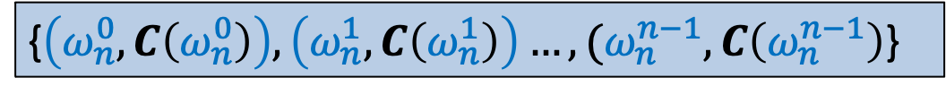

Interpolation
There is a polynomial
$$C\left(x\right)=c_{0}+c_{1}x+c_{2}x^{2}+ …c_{n−1}x^{n−1}$$
with $c_{j}$’s unknown.
Given: the following (point, value) representation of $C\left(x\right)$:
Aim: To compute $c_{j}$’s .
{$\left(ω_{n}^{0}, C\left(ω_{n}^{0}\right)\right),\left(ω_{n}^{1}, C\left(ω_{n}^{1}\right)\right)…,(ω_{n}^{n−1}, C\left(ω_{n}^{n−1}\right)$}

Slide 13
Interpolation
Polynomial Interpolation = Polynomial evaluation
Can you guess the polynomial whose evaluation will help solve polynomial interpolation ?
Make an obvious guess.

Slide 14
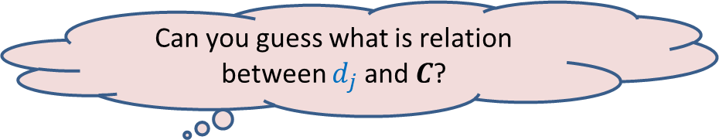

Interpolation
Solution:
Define a polynomial
$D\left(x\right)=d_{0}+d_{1}x+ …+d_{j}x^{j}+ …d_{n−1}x^{n−1}$, where $d_{j}=$ $C\left(ω_{n}^{j}\right)$.
Evaluate $D$ on $R_{n}$.
This will help us extract coefficient of $C$. ☺
What is $D\left(ω_{n}^{ℓ}\right)$ ?
Can you guess what is relation between $d_{j}$and $C$?

Slide 15

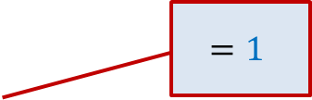

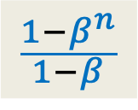


A Tool you might find helpful
$$\{1, ω_{n} ,ω_{n}^{2},ω_{n}^{3},…,ω_{n}^{n−1}\}$$
Question : = ?
If $β=1$,
Otherwise
$$β∈$$
$$=1$$
$$n$$
$$\sum_{0≤j<n}{{\left(β\right)}^{j} }$$
0
$$\frac{1−β^{n}}{1−β}$$

Slide 16
The Stable Marriage Problem

Slide 17
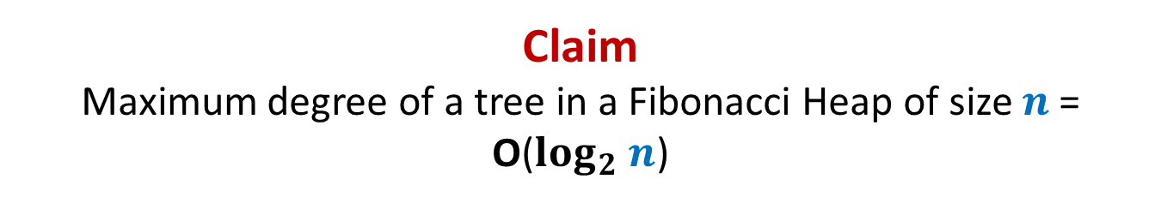












Stable Marriage Problem
Women
Men
$$w_{1}$$
$$m_{1}$$
$$3$$
…
$$w_{2}$$
$$m_{2}$$
$$1$$
…..
$$w_{3}$$
$$m_{3}$$
$$2$$
$$w_{i}$$
$$m_{j}$$
$$w_{n}$$
$$m_{n}$$

Slide 18




Stable Marriage Problem
Women
Men
$$w_{1}$$
$$m_{1}$$
$$3$$
$$w_{2}$$
$$m_{2}$$
…
…
$$1$$
$$w_{3}$$
$$m_{3}$$
…..
$$2$$
$$k$$
$$w_{i}$$
$$m_{j}$$
$$w_{n}$$
$$m_{n}$$

Slide 19
Stable Marriage Problem
Women
Men
Marriage : ?
$$w_{1}$$
$$m_{1}$$
$$w_{2}$$
$$m_{2}$$
$$w_{3}$$
$$m_{3}$$
…
…
$$w_{i}$$
$$m_{j}$$
…
…
$$w_{n}$$
$$m_{n}$$
a bijection between Women and Men

Slide 20




Stable Marriage Problem
Meaning of unstability
$w_{l}$ prefers $m_{j}$ to $m_{k}$
$m_{j}$ prefers $w_{l}$ to $w_{i}$
Definition:
A marriage is said to be stable if there is no unstable pair in the society.
($w_{l}$, $m_{j}$) : an unstable pair
$$w_{l}$$
divorce
$$m_{k}$$
$$w_{i}$$
divorce
$$m_{j}$$

Slide 21

Stable Marriage Problem
$M$ : set of $n$men
$W$ : set of $n$women
For each man $m∈M$,
$L(m)$: a preference list of all women
For each woman $w∈W$,
$L(w)$: a preference list of all men
Aim: To compute a stable marriage.

Slide 22
Algorithm for Stable Marriage
1962, David Gale and Lloyd Shapley
Nobel Prize in Economic Sciences, 2012
Man proposes, God disposes
Woman

Slide 23



Man proposes, Woman disposes
Women
Men
$$w_{1}$$
$$m_{1}$$
$$2$$
$$w_{2}$$
$$m_{2}$$
$$1$$
$$w_{3}$$
$$m_{3}$$
$$1$$
$$1$$
$$w_{i}$$
$$m_{j}$$
$$w_{n}$$
$$m_{n}$$

Slide 24
Design the algorithm now …
Rule for Men
A man proposes in the decreasing order of preference.
Once rejected by a woman, the man never proposes to her again.
A woman, if single, accepts a proposal.
A woman, if engaged, accepts a proposal from a man if she prefers him to her current partner.
Rule for Women

Slide 25
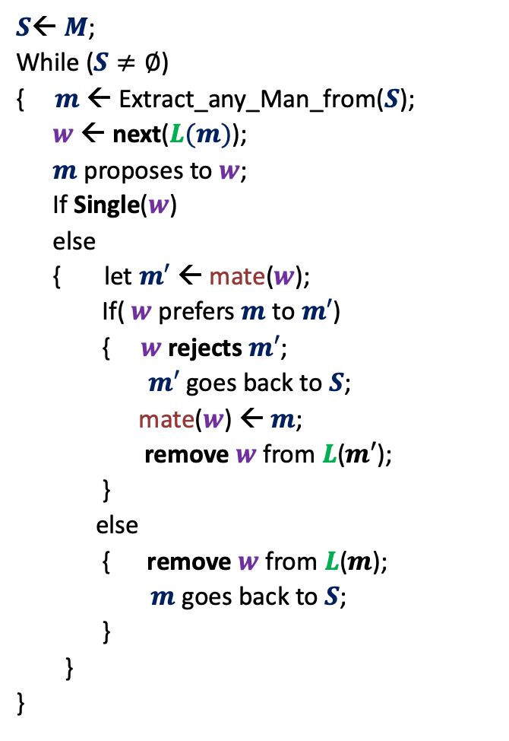



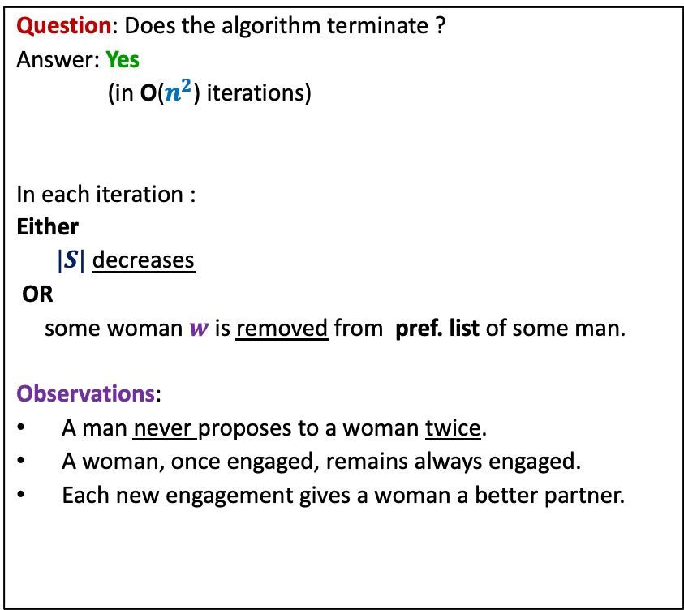
GaleShapley($M$, $W$)
$S$← $M$;
While ($S≠∅$)
{ $m$← Extract_any_Man_from($S$);
$w$ ← next($L(m)$);
$m$ proposes to $w$;
If Single($w$)
else
{ let $m′$ ← mate($w$);
If( $w$ prefers $m$ to $m′$)
{ $w$rejects $m′$;
$m′$ goes back to $S$;
mate($w$) ← $m$;
remove $w$from $L$($m′$);
}
else
{ remove $w$from $L$($m$);
$m$ goes back to $S$;
}
}
}
Question: Does the algorithm terminate ?
Answer: Yes
(in O($n^{2}$) iterations)
In each iteration :
Either
$|S|$ decreases
OR
some woman $w$is removed from pref. list of some man.
Observations:
A man never proposes to a woman twice.
A woman, once engaged, remains always engaged.
Each new engagement gives a woman a better partner.
mate($w$) ← $m$;
Any measure of progress ?
in list $L(w)$, $m$precedes $m′$)

Slide 26


GaleShapley($M$, $W$)
(Proof of stability)
There is no unstable pair in the marriage.
How to restate it so that we can prove it easily ?
Lemma :
If $m_{j}$ prefers $w_{l}$ to $w_{i}$
➔ $w_{l}$ prefers $m_{k}$ to $m_{j}$.
Homework: Prove the lemma stated above.
$$w_{l}$$
$$m_{k}$$
$$w_{i}$$
$$m_{j}$$
Hint: Make use of the following observation.
Each new engagement gives a woman a better partner (mate).

